Slide 1
CMP309 Project Max Clow 1904985
Reminders App

Slide 2
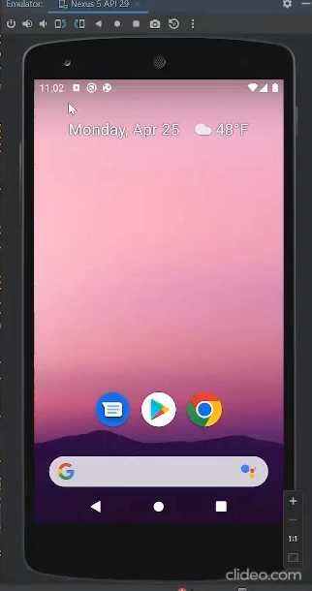
Reminders App - Demonstration
User can set a reminder with date, time, location and the information of the reminder
User can choose a one time, daily or weekly reminder
Fragments and Nav bar used for viewing stored reminders in different formats
Layout handling for portrait and landscape

Slide 3
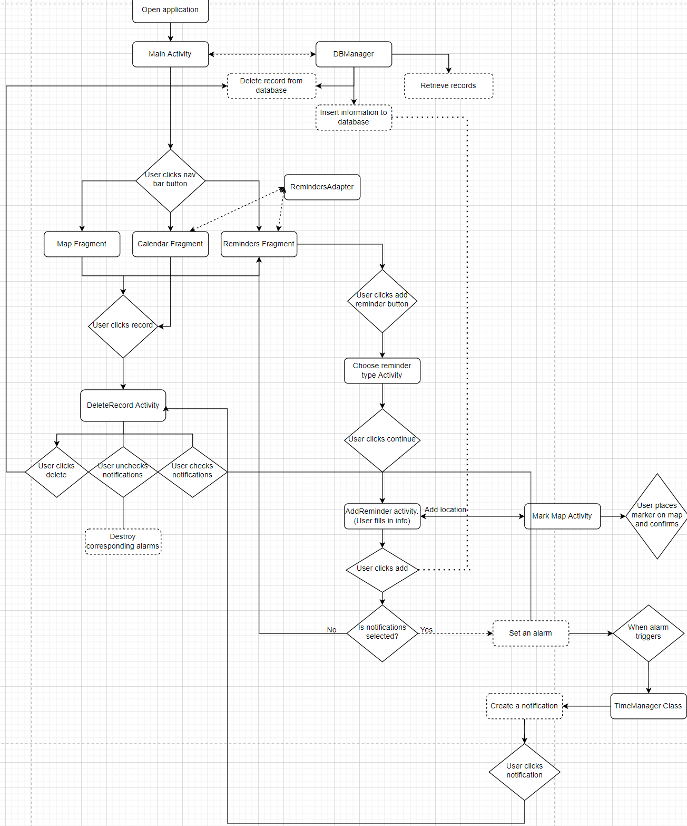
Application structure

Slide 4
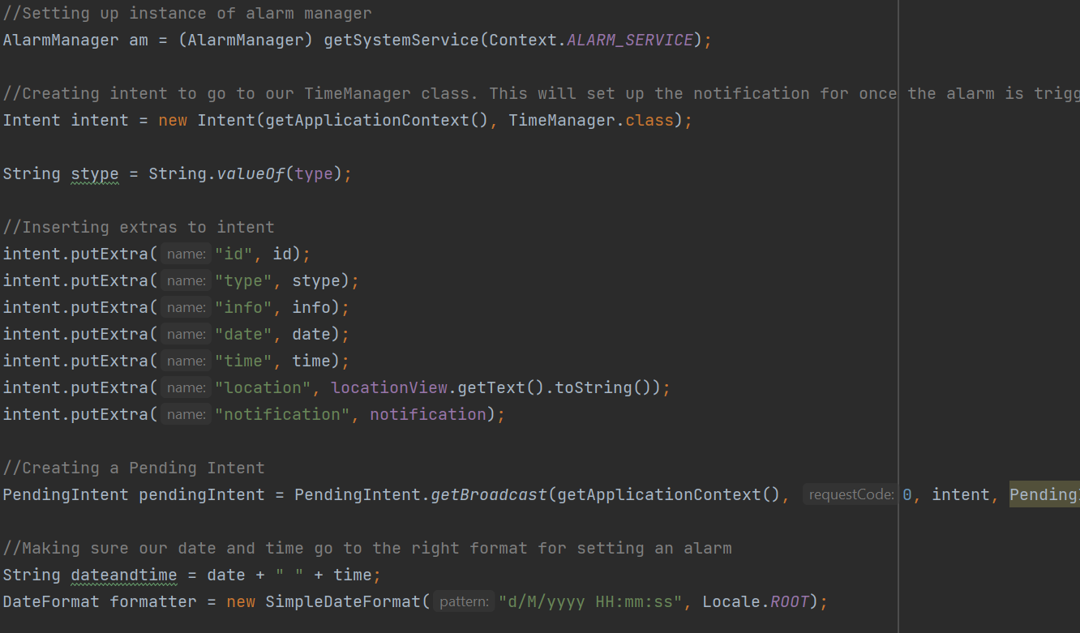
Alarms/Notifications - Alarm
This code is called either in AddReminders or DeleteRecords when notifications are enabled
Set up Alarm Manager and Intent that will go to TimeManager class
Create a pending intent with previous intent as parameter.
Begin process of getting date and time into the correct format

Slide 5
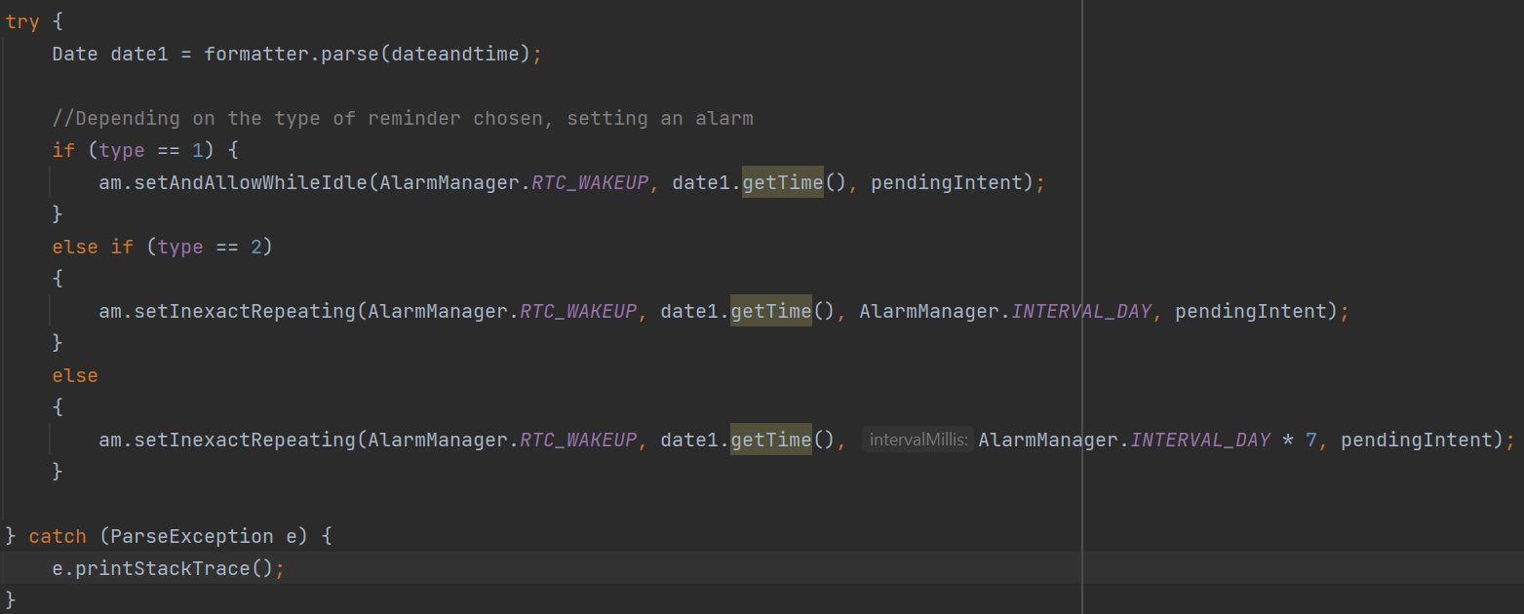
Alarms/Notifications - Alarm
Just below the previous code
Try statement needed for the .parse
Depending on what type of notification the user wants, set the alarm
setAndAllowWhileIdle allows notifications to continue, even if application is fully closed
setRepeating for continuous alarms (more on this in analysis)
Pass the previous pending intent as a parameter

Slide 6
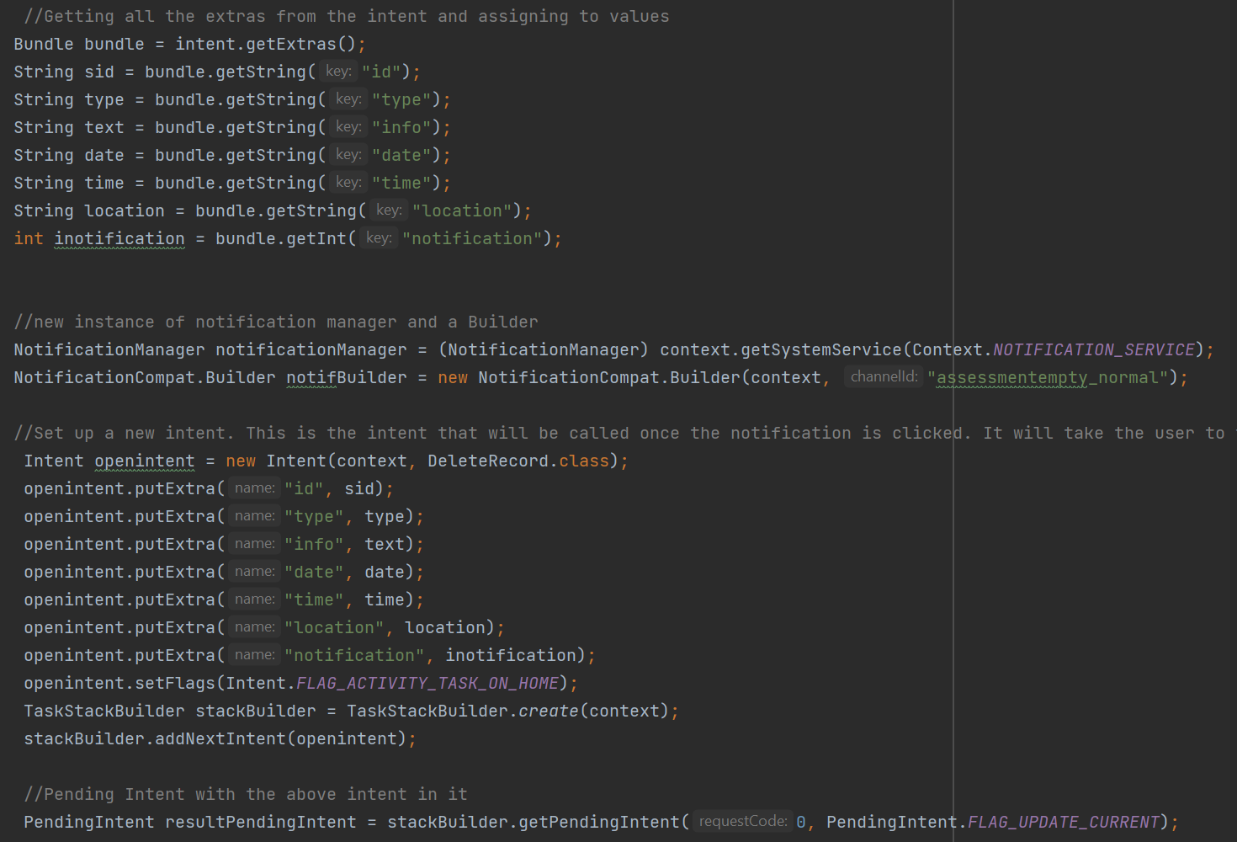
Alarms/Notifications - Notification
Code inside TimeManager class
Retrieve the extras from previous intent
Set up a notification manager and a builder
Create a NEW intent. This intent is for when the user clicks on the notification
Assign this new intent to a new pending intent

Slide 7
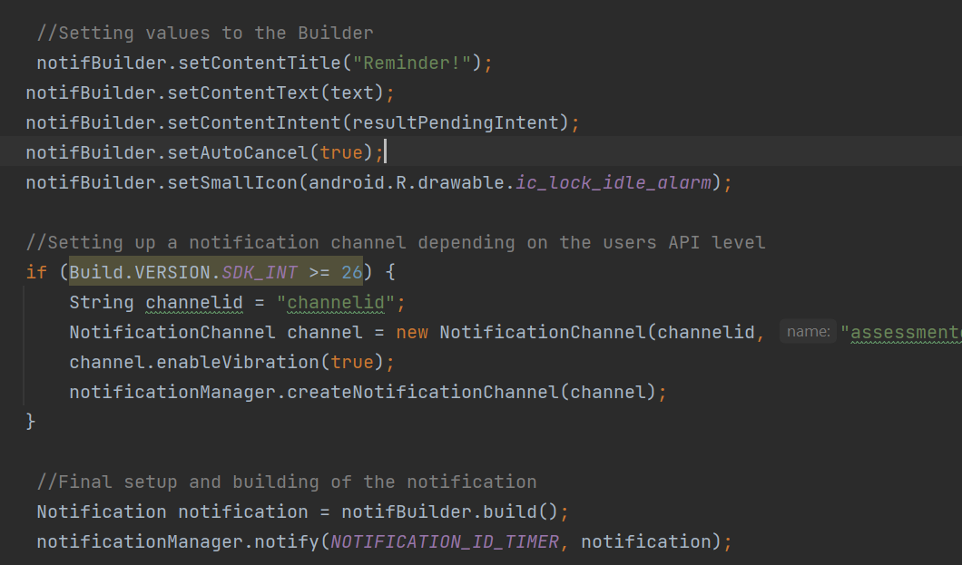
Alarms/Notifications - Notification
Assign some values to the notification builder (title, contents, icon, disappear on click)
If the users API version > 25, a notification channel must be set up
Then, the notification is built and sent to the user.
This code is only called once the alarm has been triggered

Slide 8
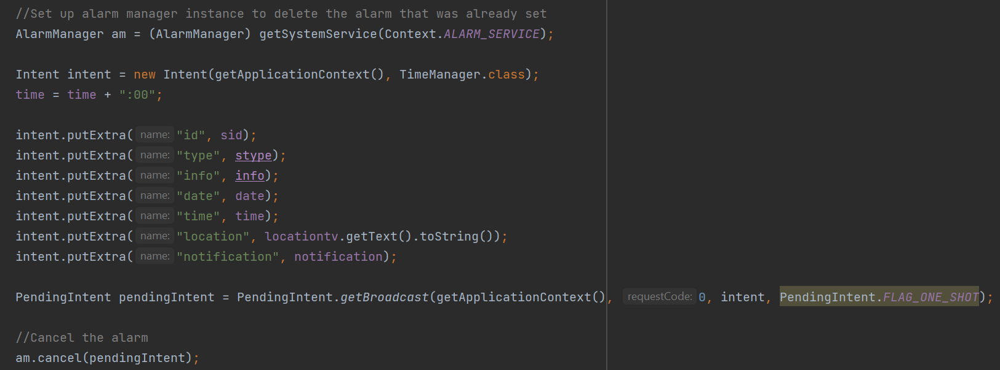
Cancelling Alarms
Switching off notifications in DeleteRecord class
Important that the intents are the exact same, otherwise the alarm can’t be found and deleted

Slide 9
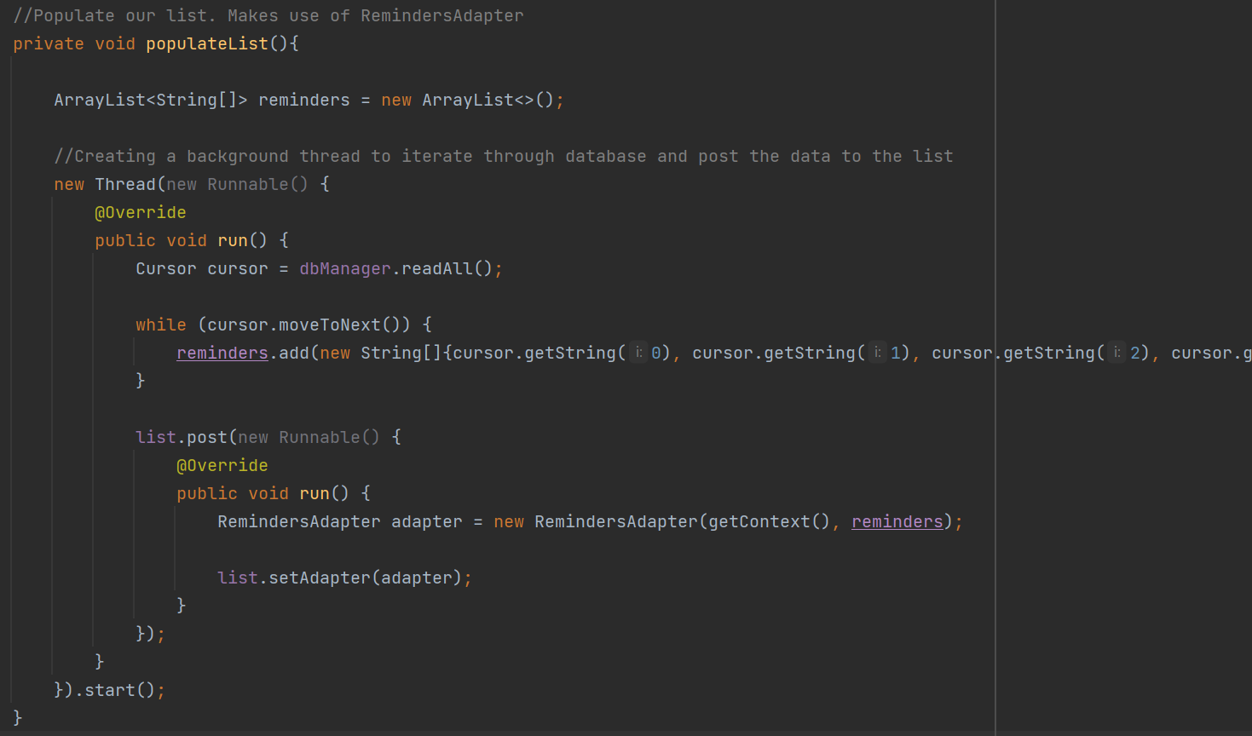
Populating lists with data
This code is called in Reminders Fragment and Calendar Fragment
Used for filling the list view with data from database
Use of background thread. Important if large amounts of data are being retrieved
Cursor retrieves all records in table, sorted by the date
Use of adapter to fill list

Slide 10
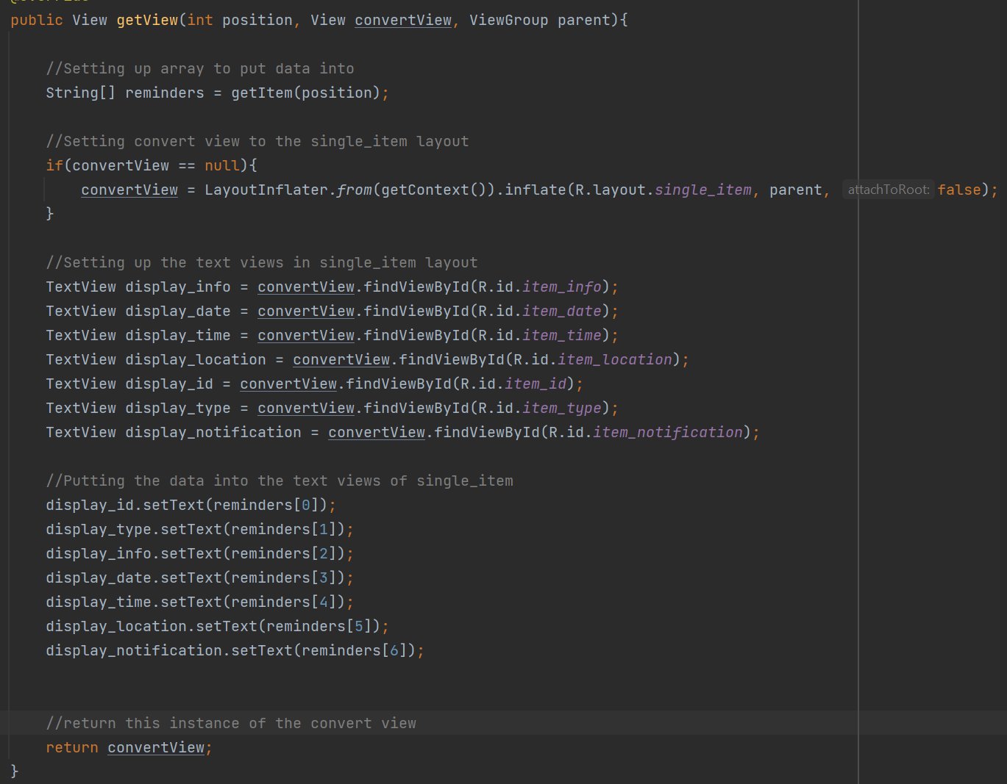
Populating lists with data
This code is from the Reminders Adapter class
An array is set up to store the currently selected data into
Set convertView to the single_item layout
Assign variables to UI elements in layout
Set the text of these variables to the data

Slide 11
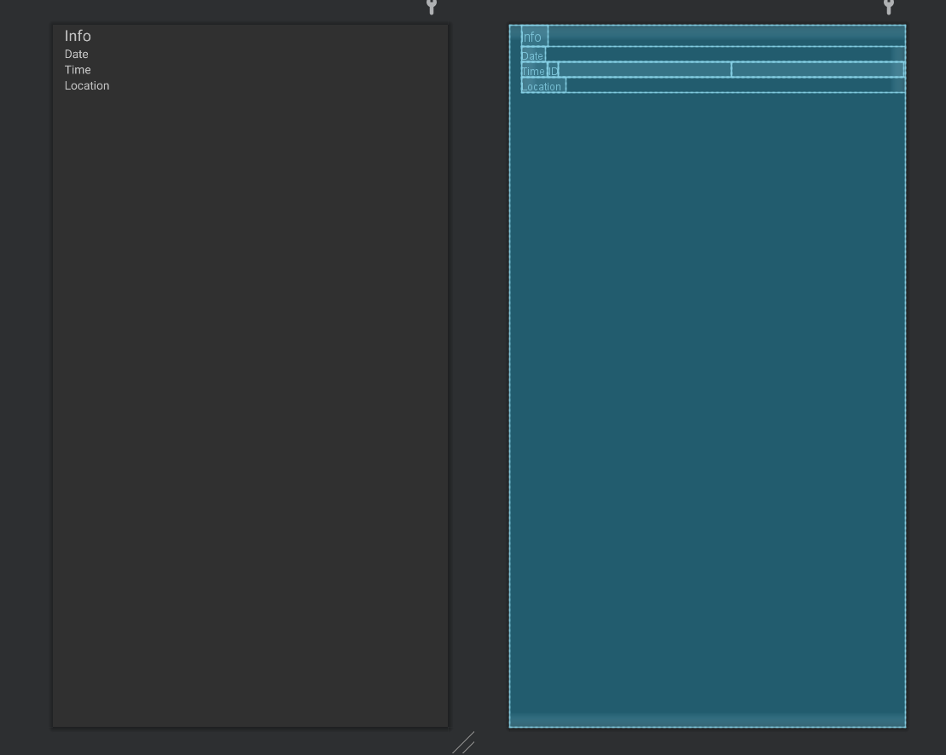
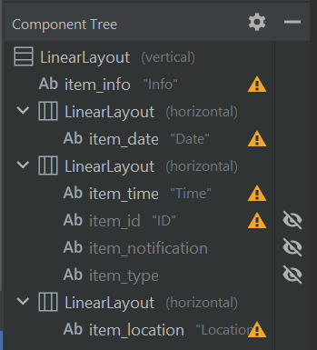
Populating lists with data
Above – The layout of single_items.xml
Below – Component tree of single_items.xml
Important user elements are displayed
Values important to the running of the program are hidden
The adapter will create as many of these layouts as required for filling the list with the data

Slide 12
Analysis - Features
Features implemented –
Notifications
Location awareness
Notifications
For a reminders app, notifications were paired with an alarm.
Different types of alarm
Opening the details of the notification on click
Some issues
Location
Maps implemented to allow the user to save and view locations if their reminder requires one
Fit for purpose, handy tool

Slide 13
Analysis – Usability + Compatibility
Orientation
Most layouts have a specific corresponding landscape layout. Full functionality between different orientations
UI elements
Kept simple with mostly buttons, text views
The inclusion of some more obscure types (switch and radio buttons) where required
Date and Time dialogs
Data
When selecting location for a reminder, the previously input data is persistent and is not removed upon moving between the two activities.
Other device types
Constraints on layouts should allow flexibility between use on other devices
Versions
Appropriate code has been included for handling notifications on newer devices

Slide 14
Analysis – Performance + Security
Security –
All appropriate permissions are requested and checked (access location, read/write storage)
No SQL injection protection
Battery
Alarm manager helps to reduce battery usage
Performance
The use of threading when populating the lists should help performance greatly when retrieving large amounts of data
Improvements
Alarms for daily/weekly improved
Perhaps a notification for if a users location gets close to a reminder

Slide 15
References
Stack Overflow (2010) Alarm Manager example. Available at: https://stackoverflow.com/questions/4459058/alarm-manager-example
Stack Overflow (2014) Get all PendingIntents set with AlarmManager. Available at: https://stackoverflow.com/questions/4315611/android-get-all-pendingintents-set-with-alarmmanager
Stack Overflow (2015) Cancel Alarm from AlarmManager. Available at: https://stackoverflow.com/questions/28922521/how-to-cancel-alarm-from-alarmmanager
Stack Overflow (2017) Retrieve data from Sqlite database and display into textview. Available at: https://stackoverflow.com/questions/44876568/android-studio-how-to-retrieve-data-from-sqlite-database-and-display-it-into-te
Tutorials Point (no date) Android –Time Picker. Available at: https://www.tutorialspoint.com/android/android_timepicker_control.htm
Tutorials Point (no date) Android – Date Picker. Available at: https://www.tutorialspoint.com/android/android_datepicker_control.htm
Stack Overflow (2018) TimePickerDialog in spinner mode. Available at: https://stackoverflow.com/questions/52775481/timepickerdialog-in-spinner-mode

